Slide 1

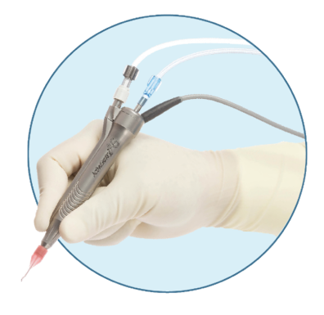
Alcon
Check-In #2

Slide 2
What we have accomplished
We have been added to Alcon’s workday system and we now have badge access to visit Alcon when we need to
We created a GitHub repository
We’ve trained on the Khine lab keyence microscope
We’re getting THESE PARTS printed
Top plate
Grippers
Stepper motor holder
We finished the aligner for the stage controller
We planned out the arduino electronic connections for the stage controller
We made more progress on the FMEA Chart

Slide 3

Plans for Early Spring
Complete our first prototype design
Complete the hardware part of our design
Allow communication it to the software portion of our design
Collect microscope images for software AI training
Test and revise our prototype design and the recognition software
Continue updating DHF
2

Slide 4
Questions
Would it be wise to use biorender for the whole poster, or should we just use biorender for specific graphics and then add them to adobe illustrator?
Would it be smart for us to dedicate extra space to explaining the purpose of our project? In the past, people have struggled to understand the test process that we are improving.

Slide 5


Thank you
3

